Slide 1
Pushdown Automata

Slide 2
Regular Languages (Review)
Regular languages are
  described by regular expressions.
  generated via regular grammars.
  accepted by
    deterministic finite automata DFA
    nondeterministic finite automata NFA
  There is an equivalence between the deterministic and nondeterministic versions
Every regular language RL is CFL
But some CFL are not regular:
  L = {a^{n}b^{n} : n ≥ 1} has CFG
    S → aSb | ab
  The language {ww^{R} : w ∈ {a, b}*} has CFG
    S → aSa | bSb | ε

Slide 3
Context-Free Languages (Review)
CFL are generated by a context-free grammar CFG
A grammar G = (NT, T, S, P) is CFG if all production rules have the form
  A → y, where A ∈ NT, and y ∈ (NT ∪ T)*
  i.e., there is a single NT on the left hand side.
A language L is CFL iff there is a CFG G such that L = L(G)
All regular languages, and some non-regular languages, can be generated by CFGs
  regular languages are a proper subset of context-free languages.

Slide 4
Stack Memory
The language L = {wcw^{R} : w ∈ {a, b}*} is CFL but not RL
  We can not have a DFA for L
  Problem is memory, DFA’s cannot remember left hand substring
What kind of memory do we need to be able to recognize strings in L?
  Answer: a stack

Slide 5
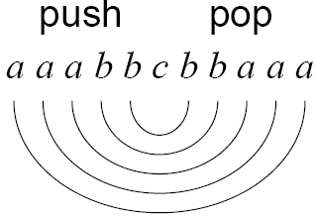
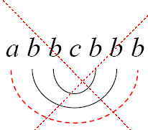
Stack Memory
Example: u = aaabbcbbaaa ∈ L
  We push the first part of the string onto the stack and
  after the c is encountered
  start popping characters off of the stack and matching them with each character.
  if everything matches, this string ∈ L

Slide 6
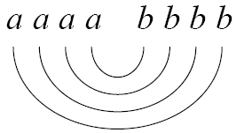
Stack Memory
We can also use a stack for counting out equal numbers of a’s and b’s.
Example:
  L = {a^{n}b^{n} : n ≥ 0}
  w = aaaabbbb ∈ L
  Push the a’s onto the stack, then pop an a off and match it with each b.
  If we finish processing the string successfully (and there are no more a’s on our stack), then the string belongs to L.

Slide 7
7.1: Nondeterministic Push-Down Automata (1)
A language is context free (CFL) iff some Nondeterministic PushDown Automata (NPDA) recognizes (accepts) it.
  Intuition: NPDA = NFA + one stack for memory.
  Stack remembers info about previous part of string
  E.g., to accept a^{n}b^{n}
Deterministic PushDown Automata (DPDA) can accept some but not all of the CFLs
Thus, there is no longer an equivalence between the deterministic and nondeterministic versions,
  i.e., languages recognized by DPDA are a proper subset of context-free languages.

Slide 8
7.1: NPDA (2)
You can only access the top element of the stack.
To access the top element of the stack, you have to pop it off the stack.
  Once the top element of the stack has been popped, if you want to save it, you need to push it back onto the stack.
Symbols from the input string must be read one symbol at a time. You cannot back up.
The current configuration (state, string, stack) of the NPDA includes:
  The current state
  the remaining symbols left in the input string, and
  the entire contents of the stack

Slide 9
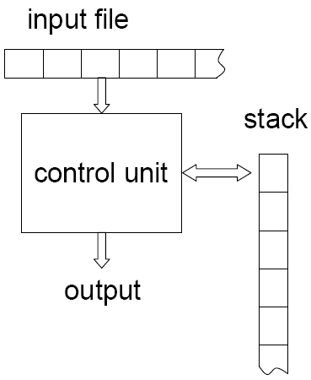
7.1: NPDA (3)
NPDA consists of
  Input file, Control unit, Stack
  Output
    output is yes/no
    indicates string belongs to given language
Each move
  reads a symbol from the input
    ε-moves are legal
  pops a symbol from the stack
    no move is possible if stack is empty
  pushes a string, right-to-left, onto the stack
  move to the target state

Slide 10
7.1: NPDA (4)
A NPDA is a seven-tuple M = (Q, Σ, Γ, δ, q₀, z, F) where
  Q finite set of states
  Σ finite set of input alphabet
  Γ finite set of stack alphabet
  δ transition function from
    Q × (Σ ∪ {ε}) × Γ → finite subsets of Q × Γ*
    δ(q_{n}, a, A) = {(q_{m}, B)}
  q₀ start state q₀ ∈ Q
  z initial stack symbol z ∈ Γ
  F final states F ⊆ Q

Slide 11
7.1: NPDA (5)
There are three things in a NPDA:
Stack
State
An input tape
q₀
tape head
Scan from left to right
z

Slide 12
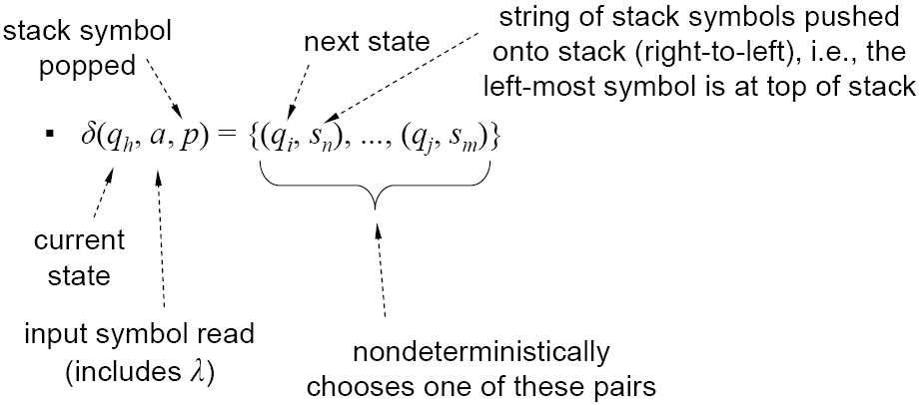
7.1: NPDA (6)
The transition function deserves further explanation
  δ : Q × (Σ ∪ {ε}) × Γ → finite subsets of Q × Γ*
  A 3-tuple mapped onto one or more 2-tuples
Transition function now depends upon three items:
  current state, input symbol, and stack symbol

Slide 13
7.1: NPDA (7)
Note that in a DFA, each transition told us that when we were in a given state and saw a specific symbol, we moved to a specified state.
In a NPDA, we read an input symbol, but we also need to know what is on the stack before we can decide what new state to move to.
When moving to the new state, we also need to decide what to do with the stack.

Slide 14
7.1: NPDA (8)
What it does mean if δ(q_{n}, a, A) = (q_{m}, B) ?
It means if
  the current state is q_{n}
  the current input letter is a
  the top of the stack is A
Then the machine should
  change the state to q_{m}
  process input letter a
  pop A off the stack
  push B onto the stack
q_{n}
a, A/B
q_{m}

Slide 15
7.1: NPDA (9)
What it does mean if δ(q_{n}, a, A) = (q_{m}, ε) ?
It means if
  the current state is q_{n}
  the current input letter is a
  the top of the stack is A
Then the machine should
  change the state to q_{m}
  process input letter a
  pop A off the stack
  don’t push anything onto the stack
q_{n}
a, A/ε
q_{m}

Slide 16
7.1: NPDA (10)
What it does mean if δ(q_{n}, a, A) = (q_{m}, BA) ?
  change the state to q_{m}
  process input letter a
  don’t pop anything from the stack
  push B onto the stack
q_{n}
a, A/BA
q_{m}

Slide 17
7.1: NPDA (11)
What it does mean if δ(q_{n}, ε, A) = (q_{m}, B) ?
  change the state to q_{m}
  don’t process any input letter
  pop A from the stack
  push B onto the stack
q_{n}
ε, A/B
q_{m}

Slide 18
7.1: NPDA (12)
What it does mean if δ(q_{n}, a, A) = (q_{m}, A) ?
  change the state to q_{m}
  process input letter a
  don’t pop anything from the stack
  don’t push anything onto the stack
q_{n}
a, A/A
q_{m}

Slide 19
7.1: NPDA (13)
popped
pushed
Language: L = {a^{n}b^{n} : n ≥ 0}
M = (Q, Σ, Γ, δ, q₀, Z, F), where
  Q = {q₀, q₁, q₂, q₃}
  Σ = {a, b}
  Γ = {Z, a}
  δ
  q₀ is the start state
  Z is the initial stack symbol
  F = {q₃}
Can be modeled with graph
  edge triplet is (input, popped, pushed)
input
input
  δ(q₀, a, Z) = {(q₁, aZ)}
  δ(q₀, ε, Z) = {(q₃, ε)}
  δ(q₁, a, a) = {(q₁, aa)}
  δ(q₁, b, a) = {(q₂, ε)}
  δ(q₂, b, a) = {(q₂, ε)}
  δ(q₂, ε, Z) = {(q₃, ε)}

Slide 20
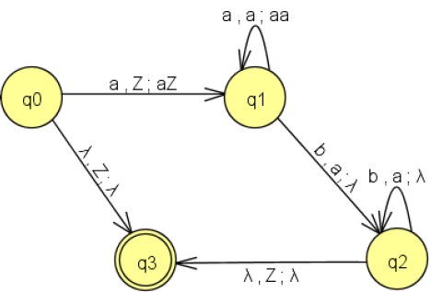
7.1: NPDA (14)
Language: L = {a^{n}b^{n} : n ≥ 0}
M = (Q, Σ, Γ, δ, q₀, Z, F), where
popped
input
input
pushed

Slide 21
7.1: NPDA (15)
A NPDA configuration is represented by
  [q_{n}, u, α] where
    q_{n} : current state
    u : unprocessed input
    α : current stack content
if δ(q_{n}, a, A) = (q_{m}, B) then [q_{n}, au, Aα]├ [q_{m}, u, Bα]
The notation [q_{n}, u, α] ├ [q_{m}, v, β] indicates that configuration [q_{m}, v, β] is obtained from [q_{n}, u, α] by a single transition of the NPDA

Slide 22
7.1: NPDA (16)
The notation [q_{n}, u, α] ├* [q_{m}, v, β] indicates that configuration [q_{m}, v, β] is obtained from [q_{n}, u, α] by zero or more transitions of the NPDA
A computation of a NPDA is a sequence of transitions beginning with start state.

Slide 23
7.1: PDA (17)
The language accepted by NPDA M is
L(M) = {w ∈ Σ* :
  Accept when out of input at a final state
    [q₀, w, z] ├* [q_{i}, ε, u] with q_{i} ∈ F
  Accept when out of input at an empty stack
    [q₀, w, z] ├* [q_{i}, ε, ε] q_{i} may not be in F
  Accept when out of input at a final state and empty stack
    [q₀, w, z] ├* [q_{i}, ε, ε] with q_{i} ∈ F

Slide 24
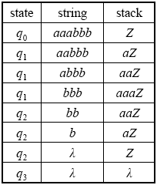
7.1: NPDA (18)
Language: L = {a^{n}b^{n} : n ≥ 0}
The computation generated by the input string aaabbb is
[q₀, aaabbb, Z] ├ [q₁, aabbb, aZ] ├ [q₁, abbb, aaZ] ├
[q₁, bbb, aaaZ] ├ [q₂, bb, aaZ] ├ [q₂, b, aZ] ├
[q₂, ε, Z] ├ [q₃, ε, ε]

Slide 25
Actions of the Example PDA
a a a b b b
q₀
Z

Slide 26
Actions of the Example PDA
a a b b b
q₁
a
Z

Slide 27
Actions of the Example PDA
a b b b
q₁
a
a
Z

Slide 28
Actions of the Example PDA
b b b
q₁
a
a
a
Z

Slide 29
Actions of the Example PDA
b b
q₂
a
a
Z

Slide 30
Actions of the Example PDA
b
q₂
a
Z

Slide 31
Actions of the Example PDA
ε
q₂
Z

Slide 32
Actions of the Example PDA
ε
q₃
ε

Slide 33
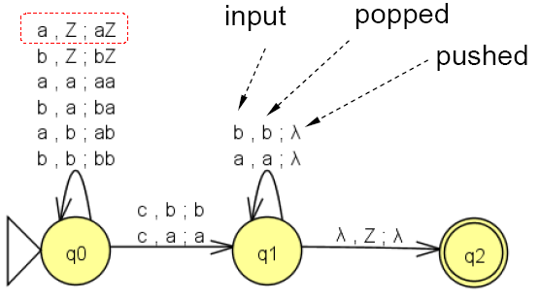
7.1: PDA (19)
L={wcw^{R} | w∈{a,b}*} is CFL and accepted by NPDA {Q={q₀,q₁,q₂},Σ={a,b,c},q₀,Γ={A,B,Z},Z,F={q₂}}
δ(q₀, a, Z) = (q₀, AZ)
δ(q₀, a, A) = (q₀, AA)
δ(q₀, a, B) = (q₀, AB)
δ(q₀, b, Z) = (q₀, BZ)
δ(q₀, b, A) = (q₀, BA)
δ(q₀, b, B) = (q₀, BB)

δ(q₀, c, Z) = (q₁, Z)
δ(q₀, c, A) = (q₁, A)
δ(q₀, c, B) = (q₁, B)
δ(q₁, a, A) = (q₁, ε)
δ(q₁, b, B) = (q₁, ε)
δ(q₁, ε, Z) = (q₂, Z)
C, Z;Z

Slide 34
7.1: PDA (20)
The computation generated by the input string abcba is
[q₀, abcba, Z]
├ [q₀, bcba, AZ]
├ [q₀, cba, BAZ]
├ [q₁, ba, BAZ]
├ [q₁, a, AZ]
├ [q₁, ε, Z]
├ [q₂, ε, Z]
C, Z;Z

Slide 35
7.1: PDA (21)
Consider w = aabcaaa
[q₀, aabcaaa, Z]
├ [q₀, abcaaa, AZ]
├ [q₀, bcaaa, AAZ]
├ [q₀, caaa, BAAZ]
├ [q₁, aaa, BAAZ]
dead configuration, w = aabcaaa ∉ L
See Examples 7.4, 7.5
C, Z;Z

Slide 36
7.1: NPDA (22)
A deterministic pushdown accepter (which we have not yet considered) must have only one transition for any given input symbol and stack symbol.
A nondeterministic pushdown accepter may have no transition or several transitions defined for a particular input symbol and stack symbol.
In a npda, there may be several “paths” to follow to process a given input string. Some of the paths may result in accepting the string. Other paths may end in a non-accepting state.
As with a nfa, a npda magically (and correctly) “guesses” which path to follow through the machine in order to accept a string (if the string is in the language).

Slide 37
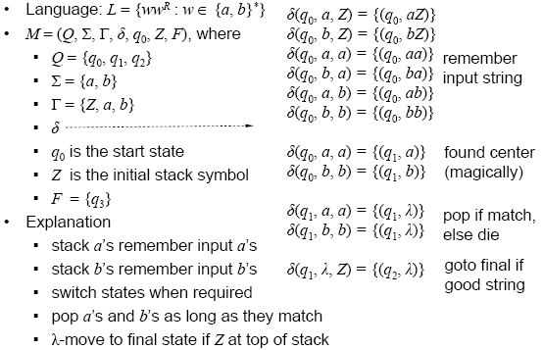
7.1: NPDA (23)
must be ε

Slide 38
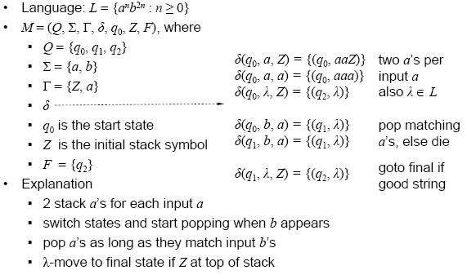
7.1: NPDA (24)

Slide 39
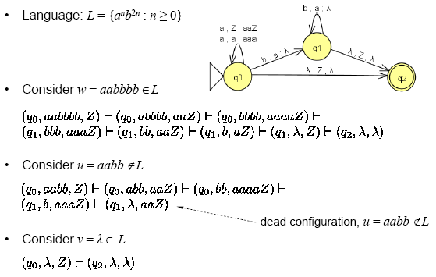
7.1: NPDA (25)

Slide 40
7.2: PDA & CFL (1)
Every CFL is accepted by PDA
  For any CFL L, there exists a PDA M such that L(M) = L
  The reverse is true as well
Let G be the CFG of L such that L(G) = L
Construct a PDA M such that L(M) = L(G) = L
  M is constructed from CFG G
  CFG ⇒ PDA

Slide 41
7.2: PDA & CFL (2)
A context-free grammar is in Greibach Normal Form (GNF) if every production is of the form
  A → aX
  where A ∈ NT, X ∈ NT*, and a ∈ Σ , i.e., A is a
Examples:
  G₁ = ({S,A}, {a,b}, S, {S→aSA | a, A→aA | b})
    GNF
  G₂ = ({S,A},{a,b}, S, {S→AS|AAS, A→SA|aa})
    not GNF

Slide 42
7.2: PDA & CFL (3)
Given a context-free grammar in GNF, the basic idea is to construct a npda that does a leftmost derivation of any string in the language.
Rules:
  always have ε-production from start state to push S onto the stack.
  push NTs on the right hand side onto the stack
  the single terminal on the right hand side is treated as input
  NT on the left hand side is the top of the stack to be popped
  have ε-production to accepting state if Z on top of stack

Slide 43
7.2: PDA & CFL (4)
Always start with δ(q₀, ε, Z) = (q₁, SZ)
  begin in state q₀, pop Z, move to q₁ without reading input, push SZ
Repeatedly apply rule
  If A → aX add δ(q₁, a, A) = (q₁, X)
  note always start and end in state q₁
  begin in state q₁, pop A, move to state q₁ while reading input a, push X
Always end with δ(q₁, ε, Z) = (q_{f}, ε)
  note Z must be at top of stack
  begin in state q₁, pop Z, move to state q_{f} without reading input sybol

Slide 44
7.2: PDA & CFL (5)
Input Grammar in Greibach NF G = (NT, Σ, P, S)
Output NPDA M = (Q, Σ, Γ, δ, q₀, Z, F)
  Q = {q₀, q₁, q_{f}}, Σ = Σ, Γ = NT ∪{Z}, F = {q_{f}}
δ:
  δ(q₀, ε, Z) = (q₁, SZ)  //always
  δ(q₁, a, A) = (q₁, w) if A → aw ∈ P
  δ(q₁, ε, Z) = (q_{f}, ε) //always

Slide 45
7.2: PDA & CFL (6)
Simple example:
  CFG G = ({S,A},{a,b}, S, {S→aSA|a,A→aA|b})
production transition
  (always) δ(q₀, ε, Z) = {(q₁, SZ)}
  S → aSA | aε δ(q₁, a, S) = {(q₁, SA), (q₁, ε)}
  A → aA δ(q₁, a, A) = {(q₁, A)}
  A → bε δ(q₁, b, A) = {(q₁, ε)}
  (always) δ(q₁, ε, Z) = {(q_{f}, ε)}

Slide 46
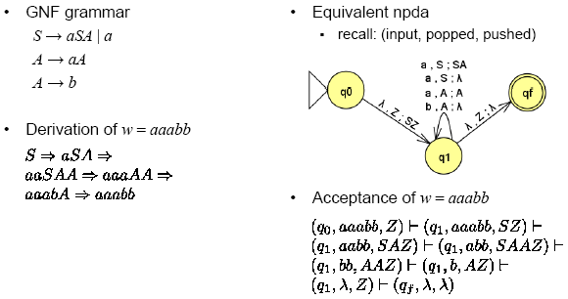
7.2: PDA & CFL (7)

Slide 47
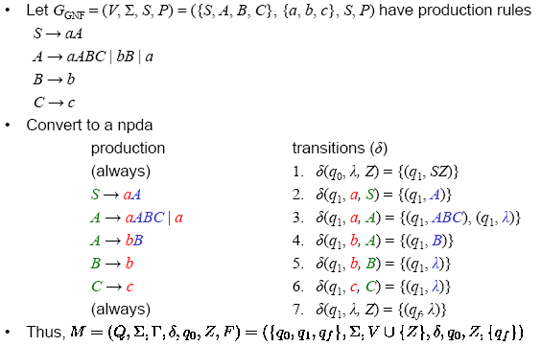
7.2: PDA & CFL (8)

Slide 48
7.2: PDA & CFL (9)
Input CFG G = {{S, A, B}, {a, b}, S, P}
  P:
    S → aAB | aB
    A → aAB | aB
    B → b
What is NPDA? What is L(G)?
a, S/AB
a, S/B
ε, Z/SZ
q₀
q₁
b, B/ε
ε, Z/ε
a, A/AB
a, A/B
q_{f}

Slide 49
7.2: PDA & CFL (10)
Computation of aaabbb
[q₀, aaabbb, Z]
├ [q₁, aaabbb, SZ]
S ⇒ aAB ├ [q₁, aabbb, ABZ]
⇒ aaABB ├ [q₁, abbb, ABBZ]
⇒ aaaBBB ├ [q₁, bbb, BBBZ]
⇒ aaabBB ├ [q₁, bb, BBZ]
⇒ aaabbB ├ [q₁, b, BZ]
⇒ aaabbb ├ [q₁, ε, Z]
├ [q_{f}, ε, ε]
On your own, draw computation trees for other strings not in the language and see that they are not accepted.

Slide 50
7.2: PDA & CFL (11)
Let CFG G = ({S, A, B}, {a, b}, S, P) where P is
  S → aAA A → aB | bB | a B → c
Construct NPDA M:
  ({q₀, q₁ , q_{f}}, {a, b}, {S, A, B, Z}, δ, q₀, {q_{f}})
where
  δ(q₀, ε, Z) = (q₁, SZ)
  δ(q₁, a, S) = (q₁, AA) S → aAA
  δ(q₁, a, A) = {(q₁, B), (q₁, ε)} A → aB | aε
  δ(q₁, b, A) = (q₁, B) A → bB
  δ(q₁, c, B) = (q₁, ε) B → cε
  δ(q₁, ε, Z) = (q_{f}, ε)

Slide 51
7.3: Deterministic PDA (1)
A PDA is deterministic if its transition function satisfies both of the following properties
  For all q ∈ Q, a ∈ Σ ∪ {ε}, and X ∈ Γ,
    the set δ(q, a, X) has at most one element
    there is only one move for any input and stack combination
  For all q ∈ Q and X ∈ Γ,
    if δ(q, ε, X) ≠ {}, then δ(q, a, X) = {} ∀ a ∈ Σ
    an ε-transition has no input-consuming alternatives, i.e., there cannot exist another move with stack = X from the same state q.

Slide 52
7.3: Deterministic PDA (2)
A language L is a deterministic context-free language if and only if there is a DPDA that accepts L.
Some context-free languages which are initially described in a
nondeterministic way via a NPDA can also be described in a deterministic way via DPDA.
Some context-free languages are inherently nondeterministic, e.g., L = {w ∈ (a|b)* : w = w^{R}} cannot be accepted by any dpda.
Deterministic PDA (DPDA) can only represent a subset of CFL, e.g., L = {ww^{R} | w ∈ (a|b)*} cannot be represented by DPDA
A key point in all this is that the equivalence between deterministic and nondeterministic finite automata is not found with deterministic and nondeterministic pushdown automata.
Unless otherwise stated, we assume that a PDA is nondeterministic

Slide 53
7.3: Deterministic PDA (3)
L = {a^{n} | n ≥ 0} ∪ {a^{n}b^{n} | n ≥ 0} is CFL and accepted by a non-deterministic PDA M
Q = {q₀, q₁, q₂}, Σ = {a, b}, Γ = {Z, A}, q₀, Z, F = {q₂}
δ(q₀, a, Ζ) = (q₀, AZ), δ(q₀, b, A) = (q₁, ε)
δ(q₀, ε, Ζ) = (q₂, ε)δ(q₁, b, A) = (q₁, ε)
δ(q₀, ε, Ζ) = (q₂, ε)δ(q₁, ε, Z) = (q₁, ε)
δ(q₂, ε, Ζ) = (q₂, ε)δ(q₂, ε, Α) = (q₂, ε)
δ(q₀, a, A) = (q₀, AA)

a, A/AA
a, Z/AZ
b, A/ε
q₀
b, A/ε
q₁
ε, Ζ/ε
ε, Ζ/ε
ε, A/ε
q₂
ε, Ζ/ε
ε, A/ε

Slide 54
7.3: Deterministic PDA (4)
The language of (strings over {a, b} of even length and spelled the same forwards and backwards) = {ww^{R} | w ∈{a, b}*} is CFL and accepted by a non-deterministic PDA M
ε, Z;Z
ε, a;a
ε, b;b

Slide 55
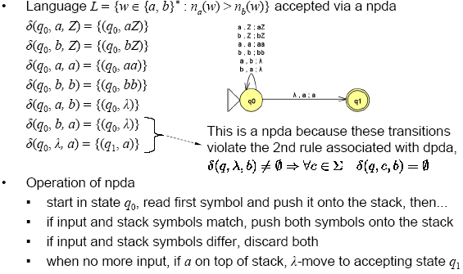
7.3: Deterministic PDA (5)

Slide 56
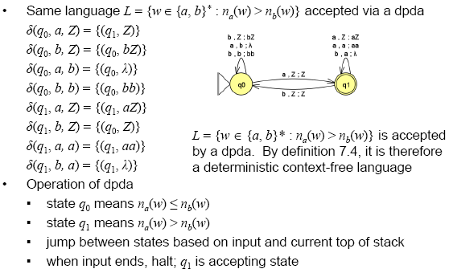
7.3: Deterministic PDA (6)

Slide 57
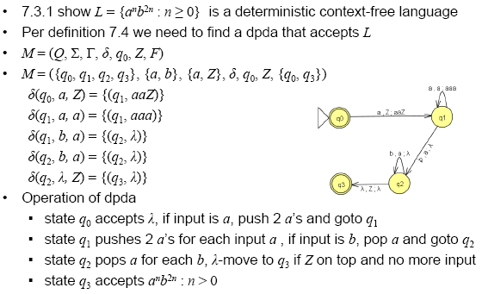
7.3: Deterministic PDA (7)

Slide 58
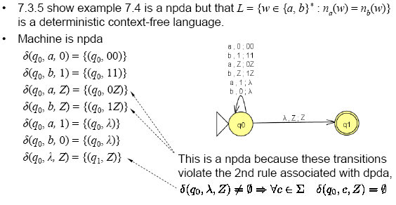
7.3: Deterministic PDA (8)

Slide 59
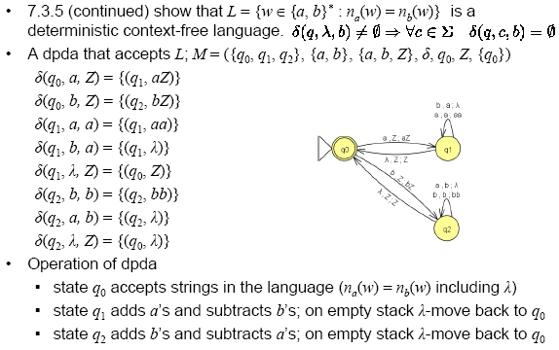
7.3: Deterministic PDA (9)

